Slide 1


Admissions and Study Permit Guide for UK & CANADA
An Averou Immigration Educational Series

Slide 2

UK VISA PROCESS
Eligibility Requirements
Unconditional Offer Letter
Confirmation of Acceptance for Studies (CAS)
Course Fee & Financial Requirement
Knowledge of English
Document Checklist
Online Application
Interview

Slide 3

Unconditional Offer Letter
UK VISA PROCESS
Eligibility Requirements
Unconditional Offer Letter
Confirmation of Acceptance for Studies (CAS)
Course Fee & Financial Requirement
Knowledge of English
Document Checklist
Online Application
Interview
Must be from a Licensed Student Sponsor (Eligible School)
https://assets.publishing.service.gov.uk/media/65b8c96487e439000dce5cf3/ 2024-01-30_-_Student_and_Child_Student.csv/preview
You cannot apply for a visa if your offer letter is conditional
Require higher IELTS score/Alternative English test score.
Require a reference letter.
Pay the deposit amount before the deadline.
Getting a pass mark in one or more specific courses or modules.
Successfully graduate from your current course.
Advised to choose another degree that is completely different from the degree that you have applied for.

Slide 4

Confirmation of Acceptance of Studies
You cannot apply for a UK without a CAS.
Once you have an unconditional offer letter, you will receive a CAS.
The CAS gives you a unique number which you will have to fill out on your study permit application.
You must apply for your study permit at least 6 months prior to the commencement of your course.

Slide 5

Money
You must have enough money to
Pay the tuition of the first year of your course (at least 9 months)
Support yourself in the UK for at least 1 year
£1,334 per month (for up to 9 months) for courses in London
£1,023 per month (for up to 9 months) for courses outside London
This money must be in your account for at least 28 consecutive days
And the 28 consecutive days must be within 31 days of the date you submit your application
Example: If you submit your application on 1 January 2024, you’d have to show that the funds were in your bank account for at least the 28-day period ending on 1 December 2023.
If you are being sponsored, the same rules apply for your sponsor’s financial records.
More details: https://www.gov.uk/guidance/financial-evidence-for-student-and-child-student route-applicants

Slide 6

Dependents
You can only bring them if:
Course is for more than 6 months.
Full-time student at the postgraduate level at a course that is 9 months or more.
Children over 18 are not dependents
You will have to show that you have enough money to support them for at least 12 months.
£845 a month (for up to 9 months) for courses in London
£680 a month (for up to 9 months) for courses outside London
You will need evidence of relationship.

Slide 7

CANADIAN STUDY PERMIT PROCESS
Eligibility Requirements
Must be enrolled in a Designated Learning Institution (DLI)
https://www.canada.ca/en/immigration-refugees-citizenship/services/study-canada/study permit/prepare/designated-learning-institutions-list.html
Tuition and Proof of Settlement Funds
Criminal Records
Medical Reports
Study Plan
Proof that you will return to home country
SDS Stream has additional requirements

Slide 8

Documents Required
Letter of Admission
Program must be more than 6 months in duration
Conditional LOA’s can receive Study Permits but only for the length required to meet your conditions.
Once you meet conditions, you will apply to extend your study permit from inside Canada
Attestation Letter (New Requirement)
Not many details are released
Masters or PHD not required to submit this
Study permit extensions are exempt
Proof of Identity
Proof of Financial Support
Study Plan
Medical Exam

Slide 9

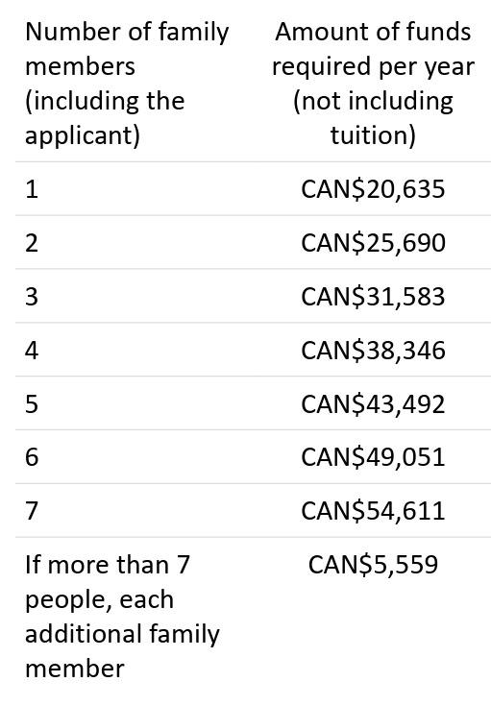
Money
SDS vs Non SDS
Non SDS
Cost of Tuition (1st year)
Proof of Settlement Funds
Financial documents accepted:
proof of a Canadian bank account in your name,
a Guaranteed Investment Certificate (GIC)
proof of a student or education loan from a bank
your bank statements for the past 4 months
a bank draft that can be converted to Canadian dollars
proof you paid tuition and housing fees
a letter from the person or school giving you money, or
proof of funding paid from within Canada

Slide 10

STUDY PLAN
Basically a Letter of Explanation
Very important part of an application
This letter helps the visa officer to understand you and your goals.
It explains:
why you want to study in Canada
that you understand your responsibilities as a student
We have our own Study Plan Guide

Slide 11

Medical Exam, Biometrics, And Police Certificate
These are admissibility requirements
Canada wants to ensure migrants are not bringing along any communicable diseases
Applicants must get a medical exam done by a panel physician https://secure.cic.gc.ca/PanelPhysicianMedecinDesigne/en/Home
You will have to get your biometrics done
Police certificate MIGHT be required

Slide 12

FACTORS THAT LEAD TO REFUSAL
Lack of Sufficient Funds
Choice of Study Program
Intent to Return to Home Country
No Job Prospects in the Home Country
Inadequate Travel History
Inadmissibility Issues

Slide 13

Lack of Sufficient Funds I
Applicants are required to provide proof of adequate finances for the first year of their program for themselves and additional family members, any.
Consider the following chart for reference:
Persons Coming to Canada | Funds required per Year (not including tuition) | Per Month conversion (not including tuition)
The Student | $21,000.00 CAD | $1750.00 CAD
First Family member | $4,000.00 CAD | $333.00 CAD
Each additional family member | $3,000.00 CAD | $255.00 CAD

Slide 14

Lack of Sufficient Funds II
Consider the following scenario:
Your tuition is $16,000.00 CAD, and your fiancé is accompanying you.
Your application must show proof of funds for $36,000 CAD.
  Tuition: $16,000 CAD
  Living: $21,000 CAD (Student)
  Living: $4,000 CAD (Family member
If your permit is refused on the basis of inadequate funding, make arrangements for funds that exceed the minimum.
Funding without a transaction history will not work.
  Example: Transfer for a lump sum right before your application
There should be a logical connection between your source of income and the amount in your bank account.

Slide 15

Lack of Sufficient Funds III
The following supporting documents are considered for proof of funds:
Bank Statements
Letters of Employment
Evidence of Assets
Letter of Invitation

Slide 16

Choice of Study of Program
Your choice of study of program must align with previous education or work history
For Example: You have been admitted to an MBA program but your previous education and work has been in nursing.
To avoid this issue, in this example, you would select a program that provides a closer link with nursing.
If you insist on doing an MBA regardless, provide an LOE that establishes a link, or explain why you chose to change direction.

Slide 17

Intent to Return To Home Country
One of the most critical factors.
Visa officer is concerned with using education as a back door for permanent settlement.
Lack of intent to return is established by:
Sparse family ties in home country.
Lack of assets in home country.
Lack of opportunity in home country.
Applicant must provide supporting documents to establish strong family ties, assets, and opportunity to avoid this issue.

Slide 18

No Job Prospects in Home Country
Similar to lack of intent to return to home country.
Officer will assess choice of program to see if it will help applicant achieve career objectives in the home country.
Officer will also assess whether those career objectives can be better met with education in the home country rather than Canada.
Applicant should provide an LOE explaining how the degree will further career prospects in home country.
An offer of prospective employment by a company in the home country can help mitigate this concern.

Slide 19

Inadequate Travel History
Lack of foreign travel history can raise red flags.
Visa officer wants to see a history of timely return to home country.
The more trips with timely return, the more satisfied a visa officer is that applicant will return home after completion of studies.
Applicant is advised to highlight such trips in their application.
If there is no travel history, applicant is advised to make arrangement for foreign trips before applying for study permit.

Slide 20

Averou’s Strategies to Address a Refusal
ATIP notes (investigate)
Reconsideration (defend)
Re-application (amend)
Judicial Review (appeal

Slide 21



